Slide 1

CSBridge
Control Flow
Control Flow Revisited
Chris Piech
CS Bridge 2020

Slide 2
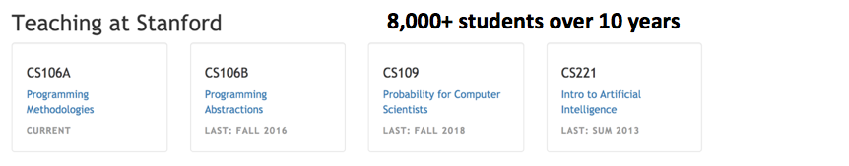

Chris Piech
I am a professor in the AI Lab at Stanford. My focus is on education and healthcare!
@chrispiech

Slide 3

Chris Piech

Slide 5
Let’s play a game

Slide 6
Truly important concepts

Slide 7
Review

Slide 8


Variable Analogy
num_students = 700
num_students
int
700
name
type
value

Slide 9
Teeny Tiny Suitcases
int
700
My computer has space for about 2 billion boxes

Slide 10
Create, Modify, Use
# Create a variable, of type int
# called age with the value 30.
age = 31
# Modify age to be one greater.
age = age + 1
# Use the value in age (output it)
print(“age is: ” + age)

Slide 11
Create, Modify, Use
# Create a variable, of type int
# called age with the value 30.
age = 31
# Modify age to be one greater.
age = age + 1
# Use the value in age (output it)
print(“age is: ” + age)
int
age
31

Slide 12
Create, Modify, Use
# Create a variable, of type int
# called age with the value 30.
age = 31
# Modify age to be one greater.
age = age + 1
# Use the value in age (output it)
print(“age is: ” + age)
int
age
31

Slide 13
Create, Modify, Use
# Create a variable, of type int
# called age with the value 30.
age = 31
# Modify age to be one greater.
age = age + 1
# Use the value in age (output it)
print(“age is: ” + age)
32
int
age
31

Slide 14
Create, Modify, Use
# Create a variable, of type int
# called age with the value 30.
age = 31
# Modify age to be one greater.
age = age + 1
# Use the value in age (output it)
print(“age is: ” + age)
32
int
age
32

Slide 15
Create, Modify, Use
# Create a variable, of type int
# called age with the value 30.
age = 31
# Modify age to be one greater.
age = age + 1
# Use the value in age (output it)
print(“age is: ” + age)
int
age
32

Slide 16
Create, Modify, Use
# Create a variable, of type int
# called age with the value 30.
age = 31
# Modify age to be one greater.
age = age + 1
# Use the value in age (output it)
print(“age is: ” + age)
int
age
32

Slide 17
Binary Operators
+
Addition
*
Multiplication
–
Subtraction
/
Division
There are others too!
%
Remainder
//
Int Division
**
Exponentiation

Slide 18
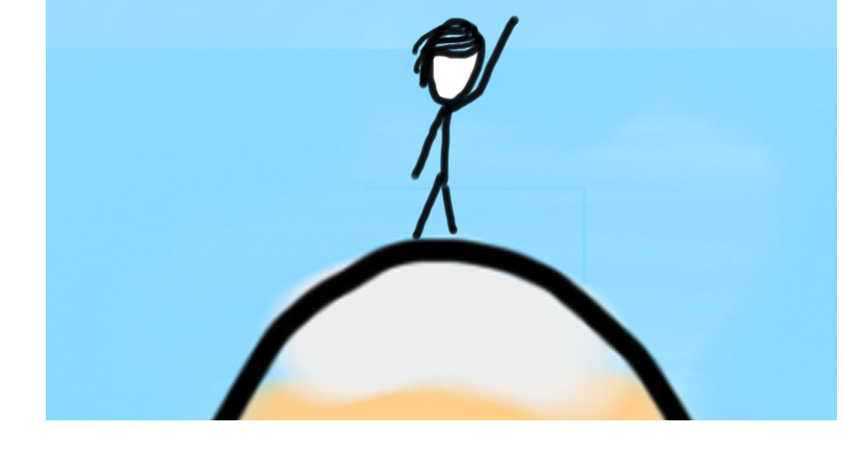

Today’s Goal
Be able to use While and If in Python
Combine loops and variables

Slide 19




Today’s Route
You are here
Python
Pairs
Booleans
Conditions
Review
The River of Python

Slide 20
Today’s Route
You are here
Python
Pairs
Booleans
Conditions
Review
The River of Python

Slide 21
While Loop in Karel
while front_is_clear() :
body
if beepers_present() :
body

Slide 22
While Loop Redux
while condition :
body
if condition :
body
The condition should be a “boolean” which is either True or False

Slide 23

Loops in Python
Use while and if statements in Python.
They are the same as in Karel, except that the test can be any expression that evaluates to True or False

Slide 24
Conditions?
Anything that resolves to a “True” or “False” answer is a condition
1 < 2

Slide 25
Conditions
Anything that resolves to a “True” or “False” answer is a condition
1 < 2
This is a comparison operator
True

Slide 26
Conditions
Anything that resolves to a “True” or “False” answer is a condition
my_var < 2
This is a comparison operator
True

Slide 27
First Example
while 1 < 2 :
print("programming is awesome!")
print("woot")

Slide 28
First Example
while 1 < 2 :
print("programming is awesome!")
print("woot")

Slide 29
First Example
while 1 < 2 :
print("programming is awesome!")
print("woot")

Slide 30
First Example
while 1 < 2 :
print("programming is awesome!")
print("woot")

Slide 31
First Example
while 1 < 2 :
print("programming is awesome!")
print("woot")

Slide 32
First Example
while 1 < 2 :
print("programming is awesome!")
print("woot")

Slide 33
First Example
while 1 < 2 :
print("programming is awesome!")
print("woot")

Slide 34
First Example
while 1 < 2 :
print("programming is awesome!")
print("woot")

Slide 35
Comparison Operators
Operator | Meaning | Example | Value
== | equals | 1 + 1 == 2 | True
!= | does not equal | 3.2 != 2.5 | True
< | less than | 10 < 5 | False
> | greater than | 10 > 5 | True
<= | less than or equal to | 126 <= 100 | False
>= | greater than or equal to | 5.0 >= 5.0 | True
* All have equal precedence

Slide 36
Comparison Operators
Operator | Meaning | Example | Value
== | equals | 1 + 1 == 2 | True
!= | does not equal | 3.2 != 2.5 | True
< | less than | 10 < 5 | False
> | greater than | 10 > 5 | True
<= | less than or equal to | 126 <= 100 | False
>= | greater than or equal to | 5.0 >= 5.0 | True
* All have equal precedence
Notes:
Equals is weird because single equals is assignment!

Slide 37
= vs ==
In python:
==
Is a comparison operator
=
Is used for variable assignment

Slide 38
Comparison Operators
if 1 < 2 :
print("1 is less than 2")
num = int(input("Enter a number: "))
if num == 0: print("That number is 0")
else :
print("That number is not 0.")
This is a condition

Slide 39
If Else Revisited
num = int(input("Enter a number: "))
if num == 0:
print("Your number is 0 ")
else:
if num > 0:
print("Your number is positive")
else:
print("Your number is negative")
Notes:
No redundant conditions

Slide 40
If Else Revisited
num = int(input("Enter a number: "))
if num == 0:
print("Your number is 0 ")
elif num > 0:
print("Your number is positive")
else:
print("Your number is negative")
Notes:
No redundant conditions

Slide 41
If Else Revisited
num = int(input("Enter a number: "))
if num == 0:
print("Your number is 0 ")
elif num > 0:
print("Your number is positive")
else:
print("Your number is negative")
Notes:
No redundant conditions

Slide 42
If Else Revisited
“5”
num = int(input("Enter a number: "))
if num == 0:
print("Your number is 0 ")
elif num > 0:
print("Your number is positive")
else:
print("Your number is negative")
Enter a number:
5
Notes:
No redundant conditions

Slide 43
If Else Revisited
5
num = int(input("Enter a number: "))
if num == 0:
print("Your number is 0 ")
elif num > 0:
print("Your number is positive")
else:
print("Your number is negative")
Enter a number:
5
Notes:
No redundant conditions

Slide 44
If Else Revisited
5
num = int(input("Enter a number: "))
if num == 0:
print("Your number is 0 ")
elif num > 0:
print("Your number is positive")
else:
print("Your number is negative")
5
Enter a number:
5
num
Notes:
No redundant conditions

Slide 45
If Else Revisited
num = int(input("Enter a number: "))
if num == 0:
print("Your number is 0 ")
elif num > 0:
print("Your number is positive")
else:
print("Your number is negative")
5
Enter a number:
5
num
Notes:
No redundant conditions

Slide 46
If Else Revisited
num = int(input("Enter a number: "))
if num == 0:
print("Your number is 0 ")
elif num > 0:
print("Your number is positive")
else:
print("Your number is negative")
5
Enter a number:
5
num
Notes:
No redundant conditions

Slide 47
If Else Revisited
num = int(input("Enter a number: "))
if num == 0:
print("Your number is 0 ")
elif num > 0:
print("Your number is positive")
else:
print("Your number is negative")
5
Enter a number:
5
Your number is positive
num
Notes:
No redundant conditions

Slide 48
If Else Revisited
num = int(input("Enter a number: "))
if num == 0:
print("Your number is 0 ")
elif num > 0:
print("Your number is positive")
else:
print("Your number is negative")
5
Enter a number:
5
Your number is positive
num
Notes:
No redundant conditions

Slide 49
Lets do it again!

Slide 50
If Else Revisited
num = int(input("Enter a number: "))
if num == 0:
print("Your number is 0 ")
elif num > 0:
print("Your number is positive")
else:
print("Your number is negative")
Notes:
No redundant conditions

Slide 51
If Else Revisited
“-2”
num = int(input("Enter a number: "))
if num == 0:
print("Your number is 0 ")
elif num > 0:
print("Your number is positive")
else:
print("Your number is negative")
Enter a number:
-2
Notes:
No redundant conditions

Slide 52
If Else Revisited
-2
num = int(input("Enter a number: "))
if num == 0:
print("Your number is 0 ")
elif num > 0:
print("Your number is positive")
else:
print("Your number is negative")
Enter a number:
-2
Notes:
No redundant conditions

Slide 53
If Else Revisited
-2
num = int(input("Enter a number: "))
if num == 0:
print("Your number is 0 ")
elif num > 0:
print("Your number is positive")
else:
print("Your number is negative")
-2
Enter a number:
-2
num
Notes:
No redundant conditions

Slide 54
If Else Revisited
num = int(input("Enter a number: "))
if num == 0:
print("Your number is 0 ")
elif num > 0:
print("Your number is positive")
else:
print("Your number is negative")
-2
Enter a number:
-2
num
Notes:
No redundant conditions

Slide 55
If Else Revisited
num = int(input("Enter a number: "))
if num == 0:
print("Your number is 0 ")
elif num > 0:
print("Your number is positive")
else:
print("Your number is negative")
-2
Enter a number:
-2
num
Notes:
No redundant conditions

Slide 56
If Else Revisited
num = int(input("Enter a number: "))
if num == 0:
print("Your number is 0 ")
elif num > 0:
print("Your number is positive")
else:
print("Your number is negative")
-2
Enter a number:
-2
num
Notes:
No redundant conditions

Slide 57
If Else Revisited
num = int(input("Enter a number: "))
if num == 0:
print("Your number is 0 ")
elif num > 0:
print("Your number is positive")
else:
print("Your number is negative")
-2
Enter a number:
-2
Your number is negative
num
Notes:
No redundant conditions

Slide 58
Amazing

Slide 59
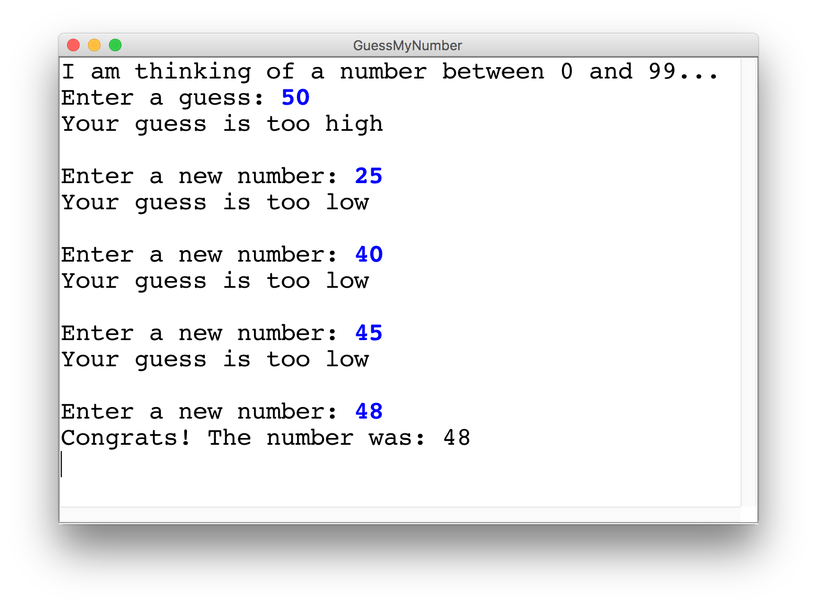
Guess My Number

Slide 60
Brace yourself!

Slide 61
Guess My Number
secret_number = random.randint(1, 99)
print("I am thinking of a number between 1 and 99...")
guess = int(input("Enter a guess: "))
# True if guess is not equal to secret number
while guess != secret_number:
# True if guess is less than secret number
if guess < secret_number:
print("Your guess is too low")
else:
print("Your guess is too high")
print("") # an empty line
guess = int(input("Enter a new guess: "))
print("Congrats! The number was: " + str(secret_number))
92
int
secret_number

Slide 62
Guess My Number
secret_number = random.randint(1, 99)
print("I am thinking of a number between 1 and 99...")
guess = int(input("Enter a guess: "))
# True if guess is not equal to secret number
while guess != secret_number:
# True if guess is less than secret number
if guess < secret_number:
print("Your guess is too low")
else:
print("Your guess is too high")
print("") # an empty line
guess = int(input("Enter a new guess: "))
print("Congrats! The number was: " + str(secret_number))
92
int
secret_number

Slide 63
Guess My Number
secret_number = random.randint(1, 99)
print("I am thinking of a number between 1 and 99...")
guess = int(input("Enter a guess: "))
# True if guess is not equal to secret number
while guess != secret_number:
# True if guess is less than secret number
if guess < secret_number:
print("Your guess is too low")
else:
print("Your guess is too high")
print("") # an empty line
guess = int(input("Enter a new guess: "))
print("Congrats! The number was: " + str(secret_number))
50
int
92
int
guess
secret_number

Slide 64
Guess My Number
secret_number = random.randint(1, 99)
print("I am thinking of a number between 1 and 99...")
guess = int(input("Enter a guess: "))
# True if guess is not equal to secret number
while guess != secret_number:
# True if guess is less than secret number
if guess < secret_number:
print("Your guess is too low")
else:
print("Your guess is too high")
print("") # an empty line
guess = int(input("Enter a new guess: "))
print("Congrats! The number was: " + str(secret_number))
50
int
92
int
guess
secret_number

Slide 65
Guess My Number
secret_number = random.randint(1, 99)
print("I am thinking of a number between 1 and 99...")
guess = int(input("Enter a guess: "))
# True if guess is not equal to secret number
while guess != secret_number:
# True if guess is less than secret number
if guess < secret_number:
print("Your guess is too low")
else:
print("Your guess is too high")
print("") # an empty line
guess = int(input("Enter a new guess: "))
print("Congrats! The number was: " + str(secret_number))
50
int
92
int
guess
secret_number

Slide 66
Guess My Number
secret_number = random.randint(1, 99)
print("I am thinking of a number between 1 and 99...")
guess = int(input("Enter a guess: "))
# True if guess is not equal to secret number
while guess != secret_number:
# True if guess is less than secret number
if guess < secret_number:
print("Your guess is too low")
else:
print("Your guess is too high")
print("") # an empty line
guess = int(input("Enter a new guess: "))
print("Congrats! The number was: " + str(secret_number))
50
int
92
int
guess
secret_number

Slide 67
Guess My Number
secret_number = random.randint(1, 99)
print("I am thinking of a number between 1 and 99...")
guess = int(input("Enter a guess: "))
# True if guess is not equal to secret number
while guess != secret_number:
# True if guess is less than secret number
if guess < secret_number:
print("Your guess is too low")
else:
print("Your guess is too high")
print("") # an empty line
guess = int(input("Enter a new guess: "))
print("Congrats! The number was: " + str(secret_number))
50
int
92
int
guess
secret_number

Slide 68
Guess My Number
secret_number = random.randint(1, 99)
print("I am thinking of a number between 1 and 99...")
guess = int(input("Enter a guess: "))
# True if guess is not equal to secret number
while guess != secret_number:
# True if guess is less than secret number
if guess < secret_number:
print("Your guess is too low")
else:
print("Your guess is too high")
print("") # an empty line
guess = int(input("Enter a new guess: "))
print("Congrats! The number was: " + str(secret_number))
95
int
92
int
guess
secret_number

Slide 69
Guess My Number
secret_number = random.randint(1, 99)
print("I am thinking of a number between 1 and 99...")
guess = int(input("Enter a guess: "))
# True if guess is not equal to secret number
while guess != secret_number:
# True if guess is less than secret number
if guess < secret_number:
print("Your guess is too low")
else:
print("Your guess is too high")
print("") # an empty line
guess = int(input("Enter a new guess: "))
print("Congrats! The number was: " + str(secret_number))
95
int
92
int
guess
secret_number

Slide 70
Guess My Number
secret_number = random.randint(1, 99)
print("I am thinking of a number between 1 and 99...")
guess = int(input("Enter a guess: "))
# True if guess is not equal to secret number
while guess != secret_number:
# True if guess is less than secret number
if guess < secret_number:
print("Your guess is too low")
else:
print("Your guess is too high")
print("") # an empty line
guess = int(input("Enter a new guess: "))
print("Congrats! The number was: " + str(secret_number))
95
int
92
int
guess
secret_number

Slide 71
Guess My Number
secret_number = random.randint(1, 99)
print("I am thinking of a number between 1 and 99...")
guess = int(input("Enter a guess: "))
# True if guess is not equal to secret number
while guess != secret_number:
# True if guess is less than secret number
if guess < secret_number:
print("Your guess is too low")
else:
print("Your guess is too high")
print("") # an empty line
guess = int(input("Enter a new guess: "))
print("Congrats! The number was: " + str(secret_number))
95
int
92
int
guess
secret_number

Slide 72
Guess My Number
secret_number = random.randint(1, 99)
print("I am thinking of a number between 1 and 99...")
guess = int(input("Enter a guess: "))
# True if guess is not equal to secret number
while guess != secret_number:
# True if guess is less than secret number
if guess < secret_number:
print("Your guess is too low")
else:
print("Your guess is too high")
print("") # an empty line
guess = int(input("Enter a new guess: "))
print("Congrats! The number was: " + str(secret_number))
95
int
92
int
guess
secret_number

Slide 73
Guess My Number
secret_number = random.randint(1, 99)
print("I am thinking of a number between 1 and 99...")
guess = int(input("Enter a guess: "))
# True if guess is not equal to secret number
while guess != secret_number:
# True if guess is less than secret number
if guess < secret_number:
print("Your guess is too low")
else:
print("Your guess is too high")
print("") # an empty line
guess = int(input("Enter a new guess: "))
print("Congrats! The number was: " + str(secret_number))
95
int
92
int
guess
secret_number

Slide 74
Guess My Number
secret_number = random.randint(1, 99)
print("I am thinking of a number between 1 and 99...")
guess = int(input("Enter a guess: "))
# True if guess is not equal to secret number
while guess != secret_number:
# True if guess is less than secret number
if guess < secret_number:
print("Your guess is too low")
else:
print("Your guess is too high")
print("") # an empty line
guess = int(input("Enter a new guess: "))
print("Congrats! The number was: " + str(secret_number))
92
int
92
int
guess
secret_number

Slide 75
Guess My Number
secret_number = random.randint(1, 99)
print("I am thinking of a number between 1 and 99...")
guess = int(input("Enter a guess: "))
# True if guess is not equal to secret number
while guess != secret_number:
# True if guess is less than secret number
if guess < secret_number:
print("Your guess is too low")
else:
print("Your guess is too high")
print("") # an empty line
guess = int(input("Enter a new guess: "))
print("Congrats! The number was: " + str(secret_number))
92
int
92
int
guess
secret_number

Slide 76
Guess My Number
secret_number = random.randint(1, 99)
print("I am thinking of a number between 1 and 99...")
guess = int(input("Enter a guess: "))
# True if guess is not equal to secret number
while guess != secret_number:
# True if guess is less than secret number
if guess < secret_number:
print("Your guess is too low")
else:
print("Your guess is too high")
print("") # an empty line
guess = int(input("Enter a new guess: "))
print("Congrats! The number was: " + str(secret_number))
92
int
92
int
guess
secret_number

Slide 77
Guess My Number
secret_number = random.randint(1, 99)
print("I am thinking of a number between 1 and 99...")
guess = int(input("Enter a guess: "))
# True if guess is not equal to secret number
while guess != secret_number:
# True if guess is less than secret number
if guess < secret_number:
print("Your guess is too low")
else:
print("Your guess is too high")
print("") # an empty line
guess = int(input("Enter a new guess: "))
print("Congrats! The number was: " + str(secret_number))
92
int
92
int
guess
secret_number

Slide 78
Conditions in Python
Think about what variables you want to declare before the loop starts!

Slide 79
Guess My Number
secret_number = random.randint(1, 99)
print("I am thinking of a number between 1 and 99...")
guess = int(input("Enter a guess: "))
# True if guess is not equal to secret number
while guess != secret_number:
# True if guess is less than secret number
if guess < secret_number:
print("Your guess is too low")
else:
print("Your guess is too high")
print("") # an empty line
guess = int(input("Enter a new guess: "))
print("Congrats! The number was: " + str(secret_number))
92
int
92
int
guess
secret_number

Slide 80
Guess My Number
secret_number = random.randint(1, 99)
print("I am thinking of a number between 1 and 99...")
guess = int(input("Enter a guess: "))
# True if guess is not equal to secret number
while guess != secret_number:
# True if guess is less than secret number
if guess < secret_number:
print("Your guess is too low")
else:
print("Your guess is too high")
print("") # an empty line
guess = int(input("Enter a new guess: "))
print("Congrats! The number was: " + str(secret_number))
92
int
92
int
guess
secret_number

Slide 81
Random Integers
Minimum value
secret_number = random.randint(1, 99)
Maximum value

Slide 82
Challenge: Three Sixes in a row
Write a program that simulates one dice roll at a time. Count how many dice rolls until you get three sixes in a row!
You rolled a 6
You rolled a 6
You rolled a 3
You rolled a 2
You rolled a 1
You rolled a 4
You rolled a 6
You rolled a 6
You rolled a 6
Number of times rolled = 152
Notes:
11:45AM
Think pair share (hint: fencepost)

Slide 84
Example: Sentinel Loops
# fencepost problem!
# ask for number - post
# add number to total - fence
def main():
num_dice_rolls = 0
# repeat these lines
dice_value = random.randint(1, 6)
num_dice_rolls += 1
print(num_dice_rolls)

Slide 85
Example: Sentinel Loops
def main(): num_dice_rolls = 0 sixes_in_a_row = 0 while sixes_in_a_row < GOAL_IN_A_ROW: dice_value = random.randint(1,6) print('You rolled a ' + str(dice_value)) if dice_value == GOAL_VALUE: sixes_in_a_row += 1 else: sixes_in_a_row = 0 num_dice_rolls += 1 print(num_dice_rolls)

Slide 86
Example: Sentinel Loops
def main(): num_dice_rolls = 0 sixes_in_a_row = 0 while sixes_in_a_row < GOAL_IN_A_ROW: dice_value = random.randint(1,6) print('You rolled a ' + str(dice_value)) if dice_value == GOAL_VALUE: sixes_in_a_row += 1 else: sixes_in_a_row = 0 num_dice_rolls += 1 print(num_dice_rolls)
0
int
0
int
num_dice_rolls
sixes_in_a_row

Slide 87
Example: Sentinel Loops
def main(): num_dice_rolls = 0 sixes_in_a_row = 0 while sixes_in_a_row < GOAL_IN_A_ROW: dice_value = random.randint(1,6) print('You rolled a ' + str(dice_value)) if dice_value == GOAL_VALUE: sixes_in_a_row += 1 else: sixes_in_a_row = 0 num_dice_rolls += 1 print(num_dice_rolls)
0
int
0
int
num_dice_rolls
sixes_in_a_row

Slide 88
Example: Sentinel Loops
def main(): num_dice_rolls = 0 sixes_in_a_row = 0 while sixes_in_a_row < GOAL_IN_A_ROW: dice_value = random.randint(1,6) print('You rolled a ' + str(dice_value)) if dice_value == GOAL_VALUE: sixes_in_a_row += 1 else: sixes_in_a_row = 0 num_dice_rolls += 1 print(num_dice_rolls)
0
int
0
int
6
int
num_dice_rolls
sixes_in_a_row
dice_value

Slide 89
Example: Sentinel Loops
def main(): num_dice_rolls = 0 sixes_in_a_row = 0 while sixes_in_a_row < GOAL_IN_A_ROW: dice_value = random.randint(1,6) print('You rolled a ' + str(dice_value)) if dice_value == GOAL_VALUE: sixes_in_a_row += 1 else: sixes_in_a_row = 0 num_dice_rolls += 1 print(num_dice_rolls)
0
int
0
int
6
int
num_dice_rolls
sixes_in_a_row
dice_value

Slide 90
Example: Sentinel Loops
def main(): num_dice_rolls = 0 sixes_in_a_row = 0 while sixes_in_a_row < GOAL_IN_A_ROW: dice_value = random.randint(1,6) print('You rolled a ' + str(dice_value)) if dice_value == GOAL_VALUE: sixes_in_a_row += 1 else: sixes_in_a_row = 0 num_dice_rolls += 1 print(num_dice_rolls)
0
int
0
int
6
int
num_dice_rolls
sixes_in_a_row
dice_value

Slide 91
Example: Sentinel Loops
def main(): num_dice_rolls = 0 sixes_in_a_row = 0 while sixes_in_a_row < GOAL_IN_A_ROW: dice_value = random.randint(1,6) print('You rolled a ' + str(dice_value)) if dice_value == GOAL_VALUE: sixes_in_a_row += 1 else: sixes_in_a_row = 0 num_dice_rolls += 1 print(num_dice_rolls)
0
int
1
int
6
int
num_dice_rolls
sixes_in_a_row
dice_value

Slide 92
Example: Sentinel Loops
def main(): num_dice_rolls = 0 sixes_in_a_row = 0 while sixes_in_a_row < GOAL_IN_A_ROW: dice_value = random.randint(1,6) print('You rolled a ' + str(dice_value)) if dice_value == GOAL_VALUE: sixes_in_a_row += 1 else: sixes_in_a_row = 0 num_dice_rolls += 1 print(num_dice_rolls)
1
int
1
int
6
int
num_dice_rolls
sixes_in_a_row
dice_value

Slide 93
Example: Sentinel Loops
def main(): num_dice_rolls = 0 sixes_in_a_row = 0 while sixes_in_a_row < GOAL_IN_A_ROW: dice_value = random.randint(1,6) print('You rolled a ' + str(dice_value)) if dice_value == GOAL_VALUE: sixes_in_a_row += 1 else: sixes_in_a_row = 0 num_dice_rolls += 1 print(num_dice_rolls)
1
int
1
int
num_dice_rolls
sixes_in_a_row

Slide 94
Example: Sentinel Loops
def main(): num_dice_rolls = 0 sixes_in_a_row = 0 while sixes_in_a_row < GOAL_IN_A_ROW: dice_value = random.randint(1,6) print('You rolled a ' + str(dice_value)) if dice_value == GOAL_VALUE: sixes_in_a_row += 1 else: sixes_in_a_row = 0 num_dice_rolls += 1 print(num_dice_rolls)
1
int
1
int
4
int
num_dice_rolls
sixes_in_a_row
dice_value

Slide 95
Example: Sentinel Loops
def main(): num_dice_rolls = 0 sixes_in_a_row = 0 while sixes_in_a_row < GOAL_IN_A_ROW: dice_value = random.randint(1,6) print('You rolled a ' + str(dice_value)) if dice_value == GOAL_VALUE: sixes_in_a_row += 1 else: sixes_in_a_row = 0 num_dice_rolls += 1 print(num_dice_rolls)
1
int
1
int
4
int
num_dice_rolls
sixes_in_a_row
dice_value

Slide 96
Example: Sentinel Loops
def main(): num_dice_rolls = 0 sixes_in_a_row = 0 while sixes_in_a_row < GOAL_IN_A_ROW: dice_value = random.randint(1,6) print('You rolled a ' + str(dice_value)) if dice_value == GOAL_VALUE: sixes_in_a_row += 1 else: sixes_in_a_row = 0 num_dice_rolls += 1 print(num_dice_rolls)
1
int
1
int
4
int
num_dice_rolls
sixes_in_a_row
dice_value

Slide 97
Example: Sentinel Loops
def main(): num_dice_rolls = 0 sixes_in_a_row = 0 while sixes_in_a_row < GOAL_IN_A_ROW: dice_value = random.randint(1,6) print('You rolled a ' + str(dice_value)) if dice_value == GOAL_VALUE: sixes_in_a_row += 1 else: sixes_in_a_row = 0 num_dice_rolls += 1 print(num_dice_rolls)
1
int
1
int
4
int
num_dice_rolls
sixes_in_a_row
dice_value

Slide 98
Example: Sentinel Loops
def main(): num_dice_rolls = 0 sixes_in_a_row = 0 while sixes_in_a_row < GOAL_IN_A_ROW: dice_value = random.randint(1,6) print('You rolled a ' + str(dice_value)) if dice_value == GOAL_VALUE: sixes_in_a_row += 1 else: sixes_in_a_row = 0 num_dice_rolls += 1 print(num_dice_rolls)
1
int
0
int
4
int
num_dice_rolls
sixes_in_a_row
dice_value

Slide 99
Example: Sentinel Loops
def main(): num_dice_rolls = 0 sixes_in_a_row = 0 while sixes_in_a_row < GOAL_IN_A_ROW: dice_value = random.randint(1,6) print('You rolled a ' + str(dice_value)) if dice_value == GOAL_VALUE: sixes_in_a_row += 1 else: sixes_in_a_row = 0 num_dice_rolls += 1 print(num_dice_rolls)
2
int
0
int
4
int
num_dice_rolls
sixes_in_a_row
dice_value

Slide 100
Example: Sentinel Loops
def main(): num_dice_rolls = 0 sixes_in_a_row = 0 while sixes_in_a_row < GOAL_IN_A_ROW: dice_value = random.randint(1,6) print('You rolled a ' + str(dice_value)) if dice_value == GOAL_VALUE: sixes_in_a_row += 1 else: sixes_in_a_row = 0 num_dice_rolls += 1 print(num_dice_rolls)
1
int
0
int
4
int
num_dice_rolls
sixes_in_a_row
dice_value

Slide 101
When will it get to this line?
def main(): num_dice_rolls = 0 sixes_in_a_row = 0 while sixes_in_a_row < GOAL_IN_A_ROW: dice_value = random.randint(1,6) print('You rolled a ' + str(dice_value)) if dice_value == GOAL_VALUE: sixes_in_a_row += 1 else: sixes_in_a_row = 0 num_dice_rolls += 1 print(num_dice_rolls)
?
int
?
int
?
int
num_dice_rolls
sixes_in_a_row
dice_value

Slide 102
Logical Operators
In order of precedence:
Operator | Example | Result
not | not (2 == 3) | True
and | (2 == 3) and (-1 < 5) | False
or | (2 == 3) or (-1 < 5) | True
num1 = int(input("Enter a positive number: "))
num2 = int(input("Enter another number: "))
if num1 < 0 or num2 < 0:
print("invalid input")

Slide 103
George Boole
English Mathematician teaching in Ireland 1815 – 1864
Boole died of being too cool
Notes:
Sam the eagle

Slide 104
Boolean Variables
# Store expressions that evaluate to True/False
x = 1 < 2 # True
y = 5.0 == 4.0 # False
boolean
x
True
y
boolean
False

Slide 105
Boolean Variables
# Store expressions that evaluate to True/False
x = 1 < 2 # True
y = 5.0 == 4.0 # False
# Directly set to True/False
is_teaching = True
is_rock_climbing = False

Slide 106
Boolean Variables
# Store expressions that evaluate to True/False
x = 1 < 2 # True
y = 5.0 == 4.0 # False
# Directly set to True/False
is_teaching = True
is_rock_climbing = False
play_again = input(’Play again? "y” or "n”’) == ‘y’
if play_again:
...

Slide 108
*know your logical precedence
food = True
drinks = True
is_allowed = not food or drinks

Slide 109
*know your logical precedence
food = True
drinks = True
is_allowed = not food or drinks
False

Slide 110
*know your logical precedence
food = True
drinks = True
is_allowed = not food or drinks
False
True

Slide 111
Today’s Route
You are here
Python
Pairs
Booleans
Conditions
Review
The River of Python

Slide 112
Today’s Route
You are here
Python
Pairs
Booleans
Conditions
Review
The River of Python

Slide 114
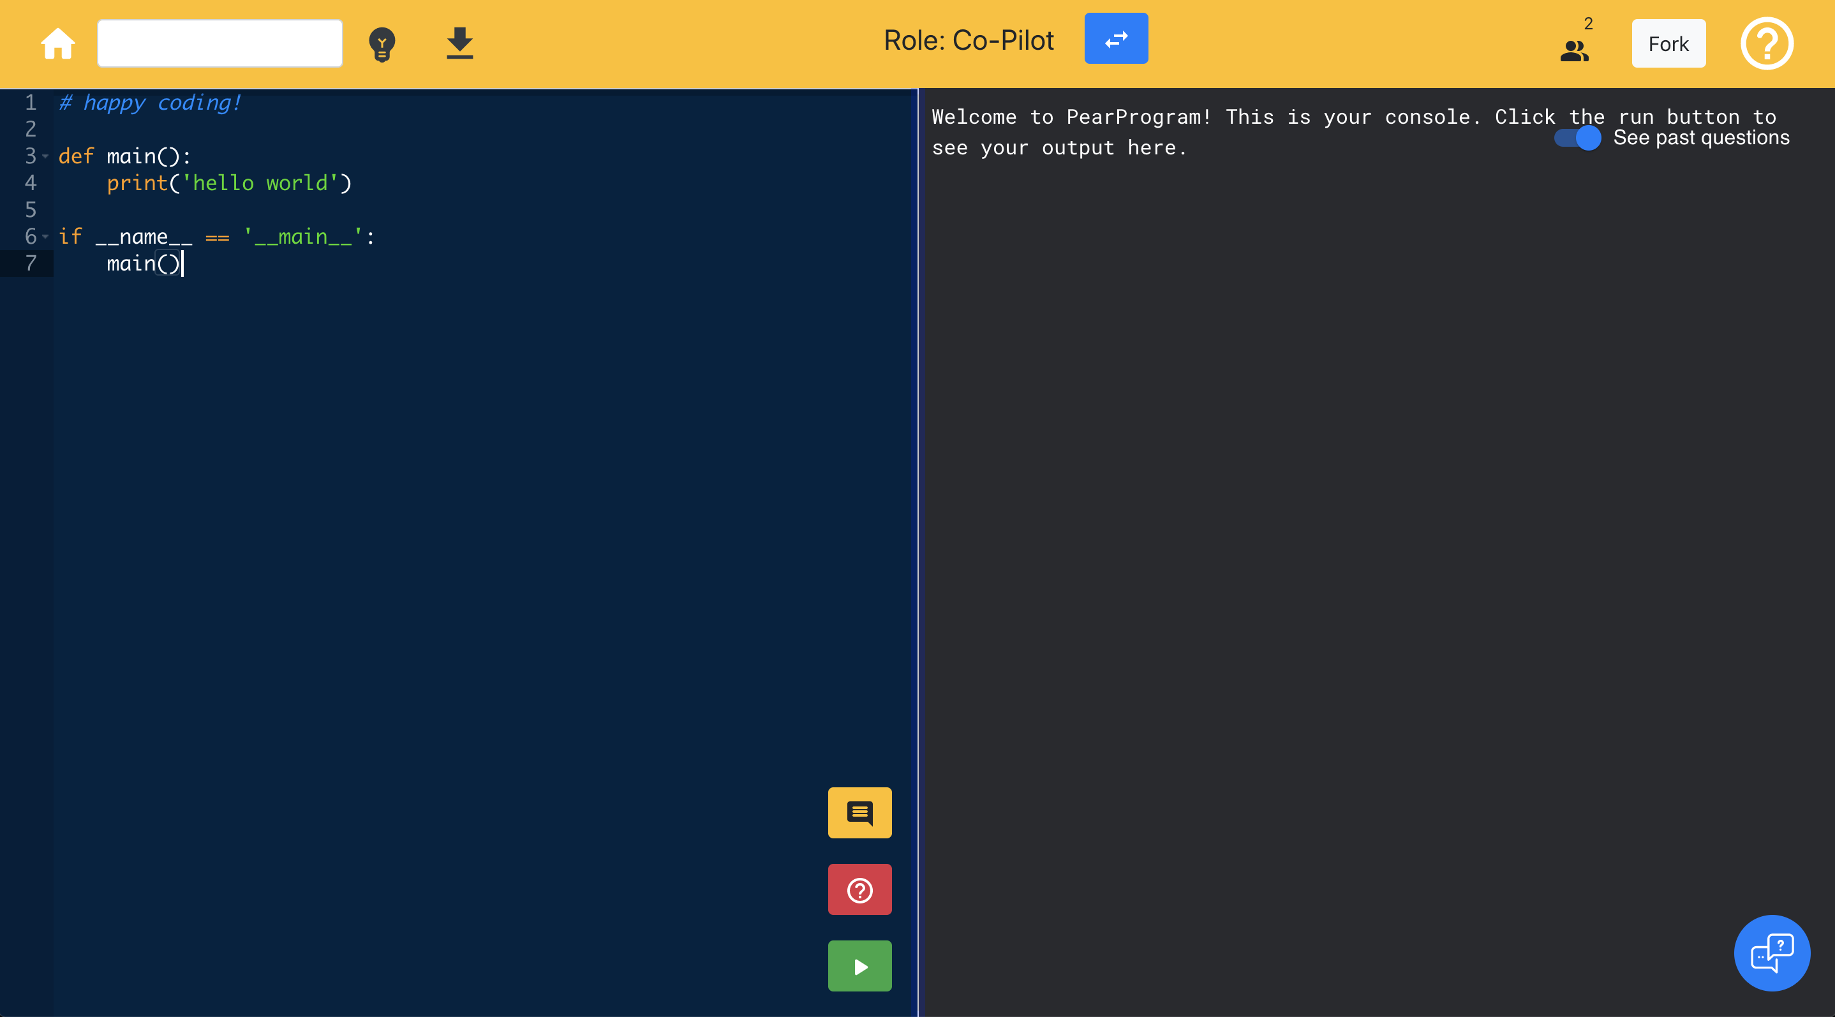
Learning to pair program
(1) There are two roles in pair programming:
Pilot and Co-Pilot
(2) Everyone must understand all the code. Ask a question if you are lost. Fell free to chat as you go!
(3) Press this button to run your code

Slide 115
Truly important afternoon

Slide 116
This is hard! Learn a little each day.

Slide 117
Today’s Goal
Be able to use While and If in Python
Combine loops and variables

Slide 118
